Slide 1
Magnetic Tunnel Junction and MRAM
Marcus Rosales

Slide 2

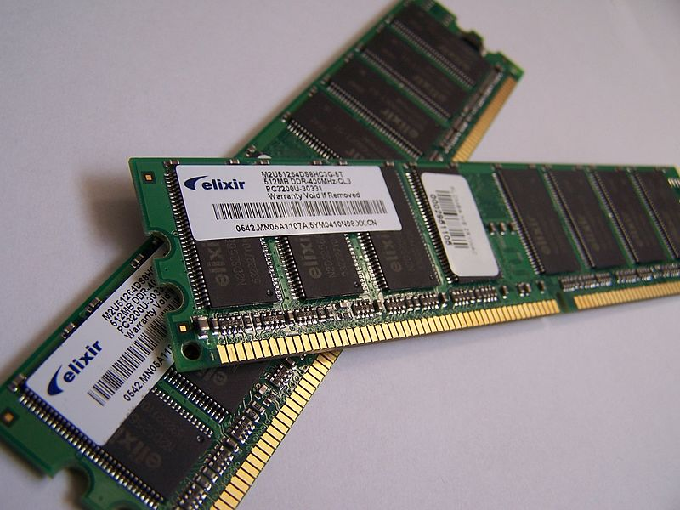
Random Access Memory
RAM
Main memory storage device
Semiconductor Memory
http://en.wikipedia.org/wiki/File:Memory_module_DDRAM_20-03-2006.jpg

Slide 3
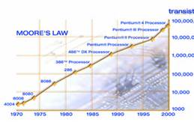
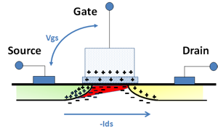
Energy Consumption
High energy consumption
Charge leakage
Heat production
Moore’s Law
http://home.fnal.gov/~carrigan/pillars/web_Moores_law.htm
http://blogs.arm.com/smart-connected-devices/110-no-need-to-whine-about-transistor-leakage/

Slide 4
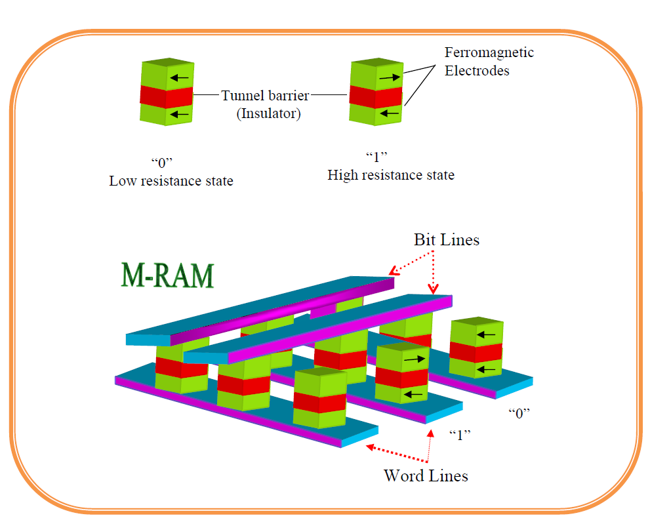
Motivations for Research
Magnetic random access memory (MRAM)
http://www.intechopen.com/books/electronic-properties-of-carbon-nanotubes/carbon-nanotube-based-magnetic-tunnel-junctions-mtjs-for-spintronics-application

Slide 5
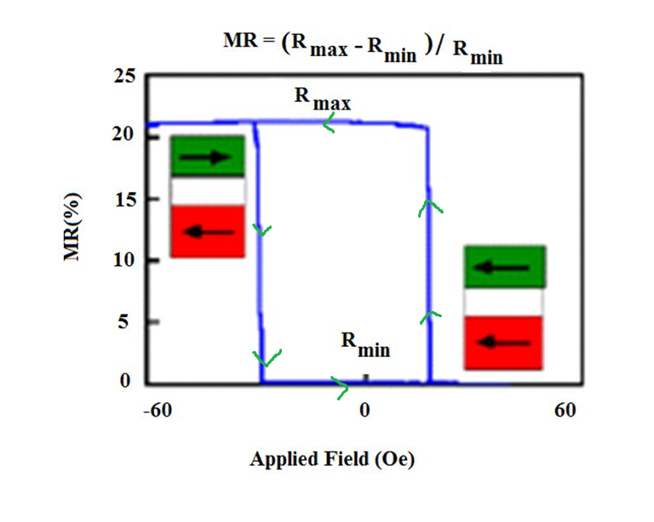
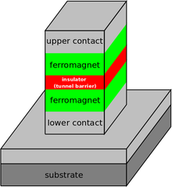
About the Research
Giant magnetoresistance (GMR)
Magnetic tunnel junction (MTJ)
Similar:
Parallel: Low Resistance
Anti-parallel: High Resistance
http://www.intechopen.com/books/electronic-properties-of-carbon-nanotubes/carbon-nanotube-based-magnetic-tunnel-junctions-mtjs-for-spintronics-application
http://en.wikipedia.org/wiki/Tunnel_magnetoresistance

Slide 6
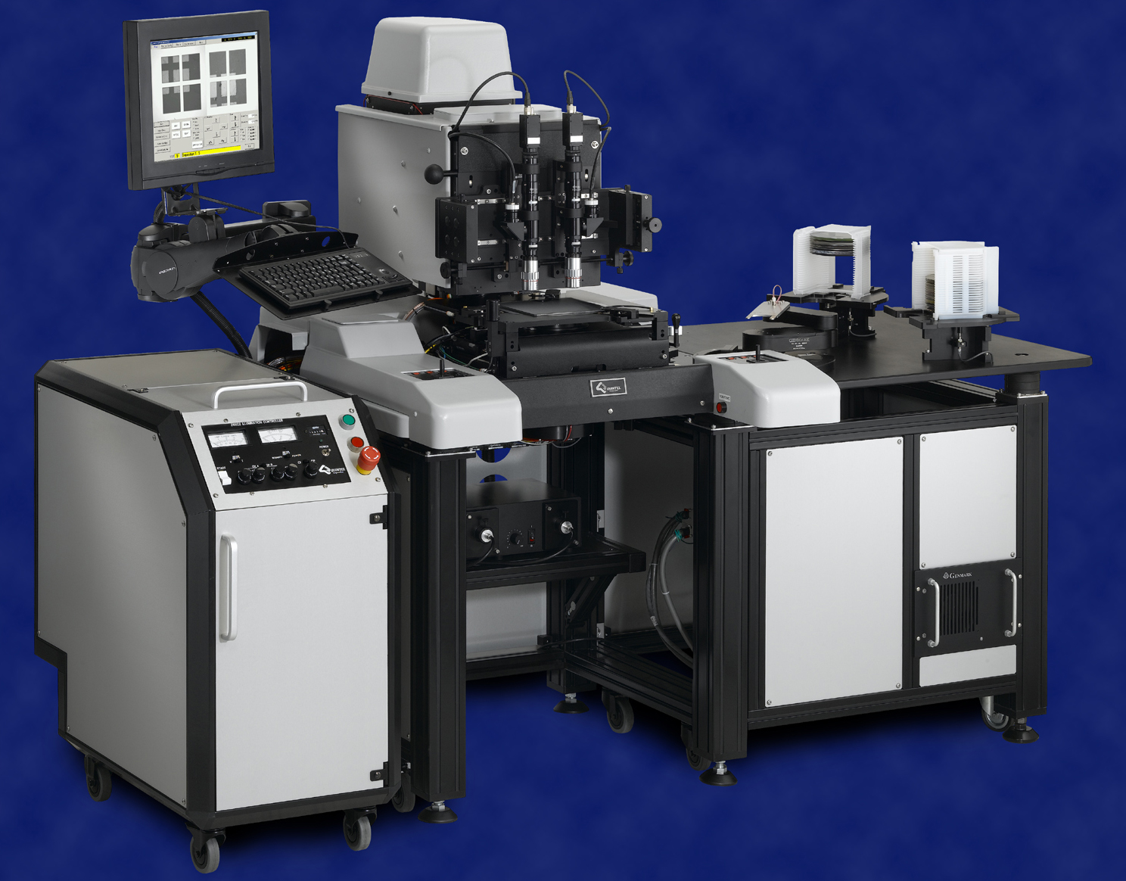
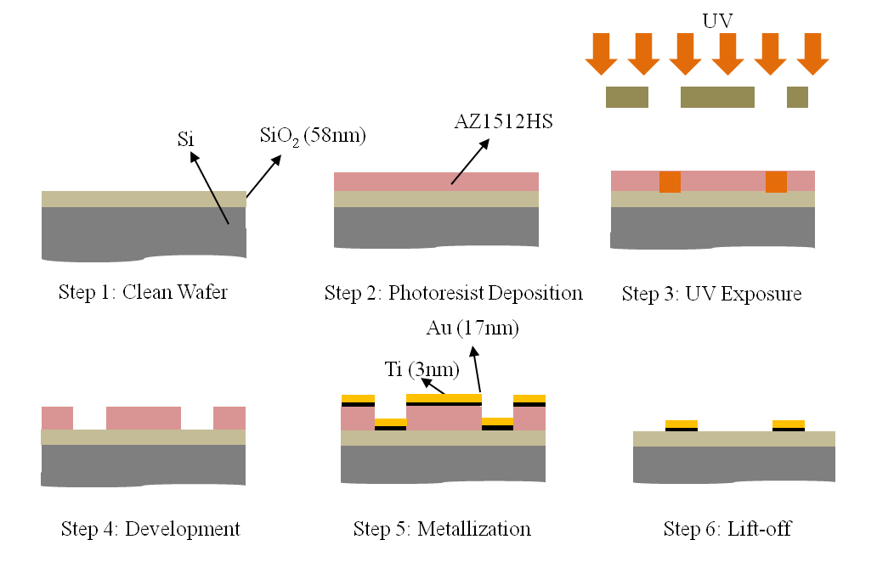
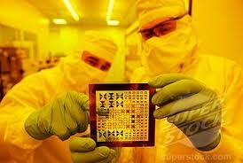
Photolithography
Photolithography
Photo=Light
Lithos=Stone
Graphy=Writing
http://www.prweb.com/releases/2007/02/prweb505378.html
http://www.superstock.com/stock-photos-images/1566-584361
http://www.dileepnanotech.com/articles/Lithography.html

Slide 7
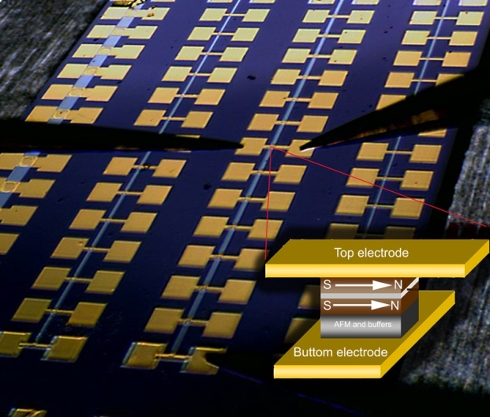
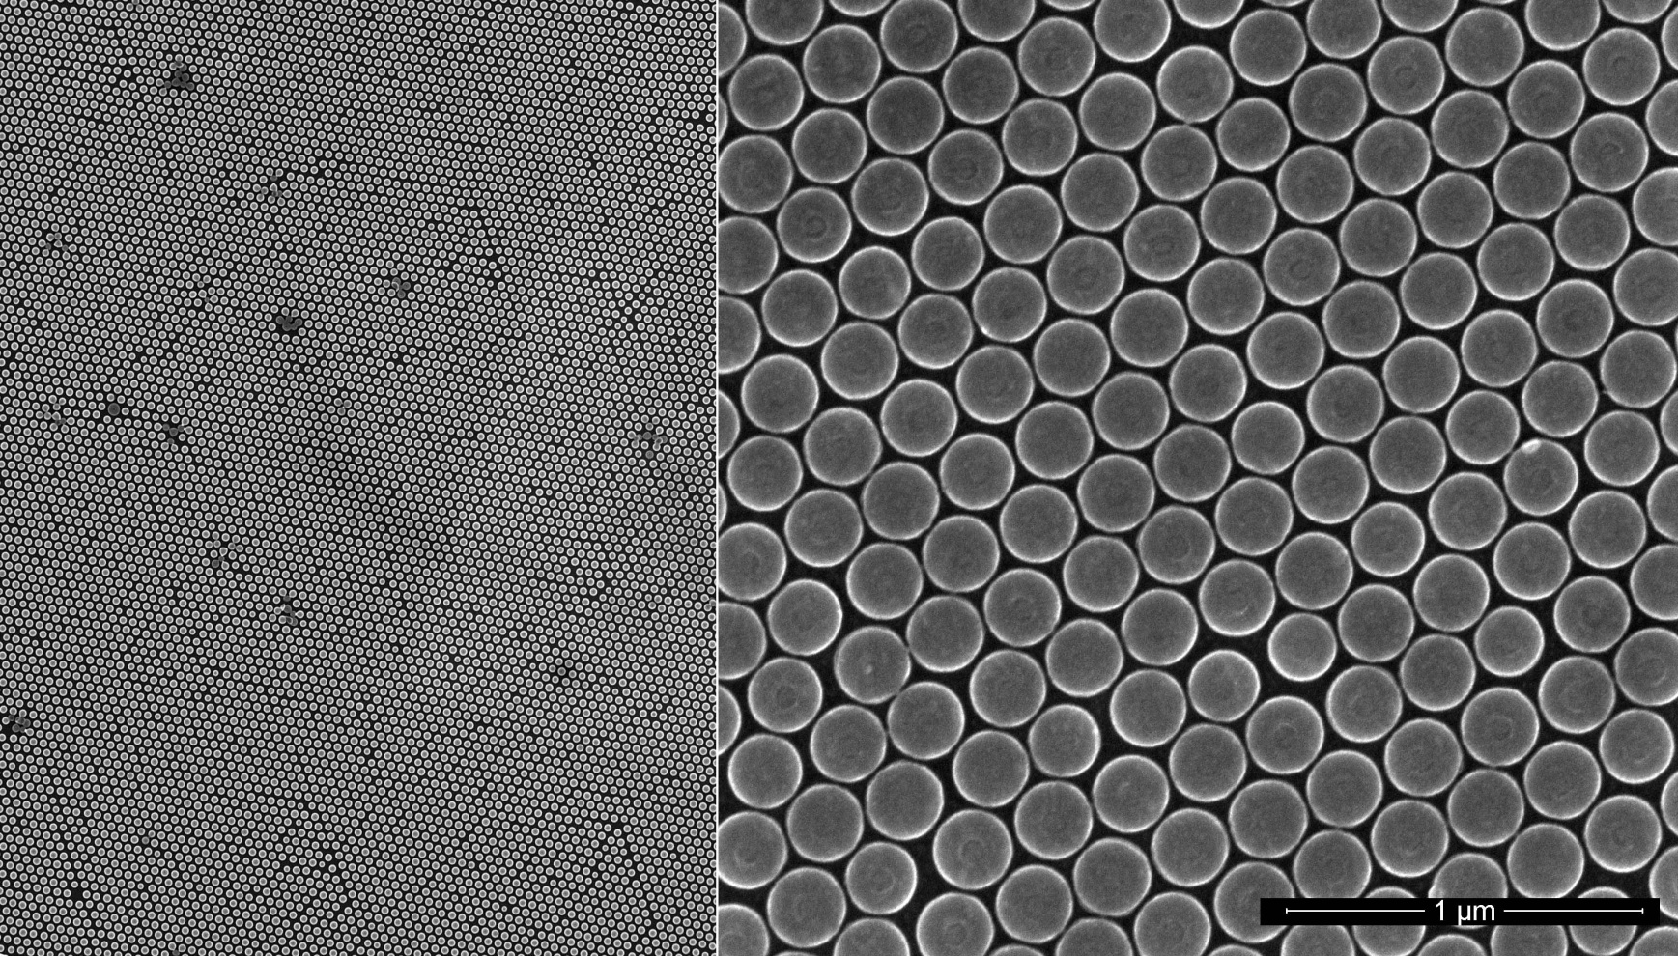
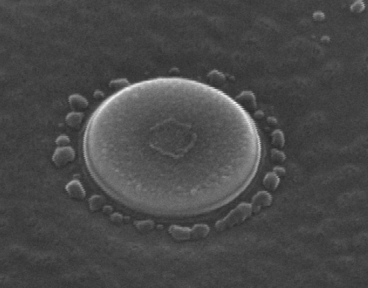
Nano-fabrication
Ru
Ta
Oxygen
Plasma
Ar ⁺ ion beam
CoFeB
Top Electrode
Deposition
Planarization
SiO₂
Deposition
MgO
CoFeB
Ru
CoFe
IrMn
CoFe
Ta
Ru
Ta
R = 200nm
Weigang Wang

Slide 8

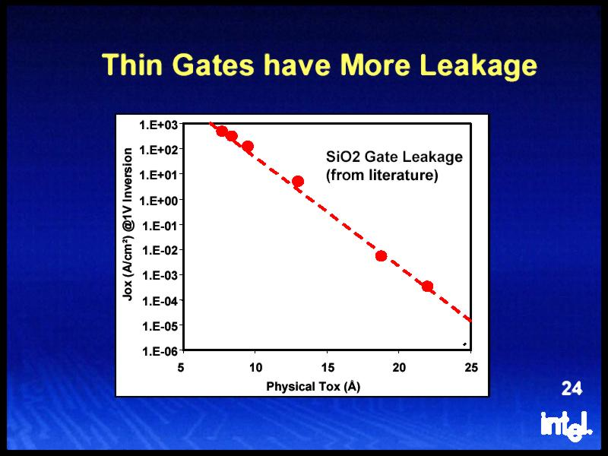
Conclusion
MTJ and spin-tronics
MRAM
Nonvolatile
Energy Efficient
Applications outside of information storage.
http://wallpoper.com/wallpaper/electronics-micro-366490
http://ixbtlabs.com/articles2/intel-65nm/

Slide 9
Acknowledgments
NSF
Nasa space grant members
Nasa space grant administration and metors
Other thanks
Rebekah Cross, Amber Hawkins, Dr. Pitucco, and Dr. Manne.
Weigang Wang
Graduate students:
Ty Newhouse-Illige
Hamid Almasi
Undergraduate students:
Christian Dane Gentry

Slide 10

Questions
http://bent-almaghreb.blogspot.com/

Slide 11
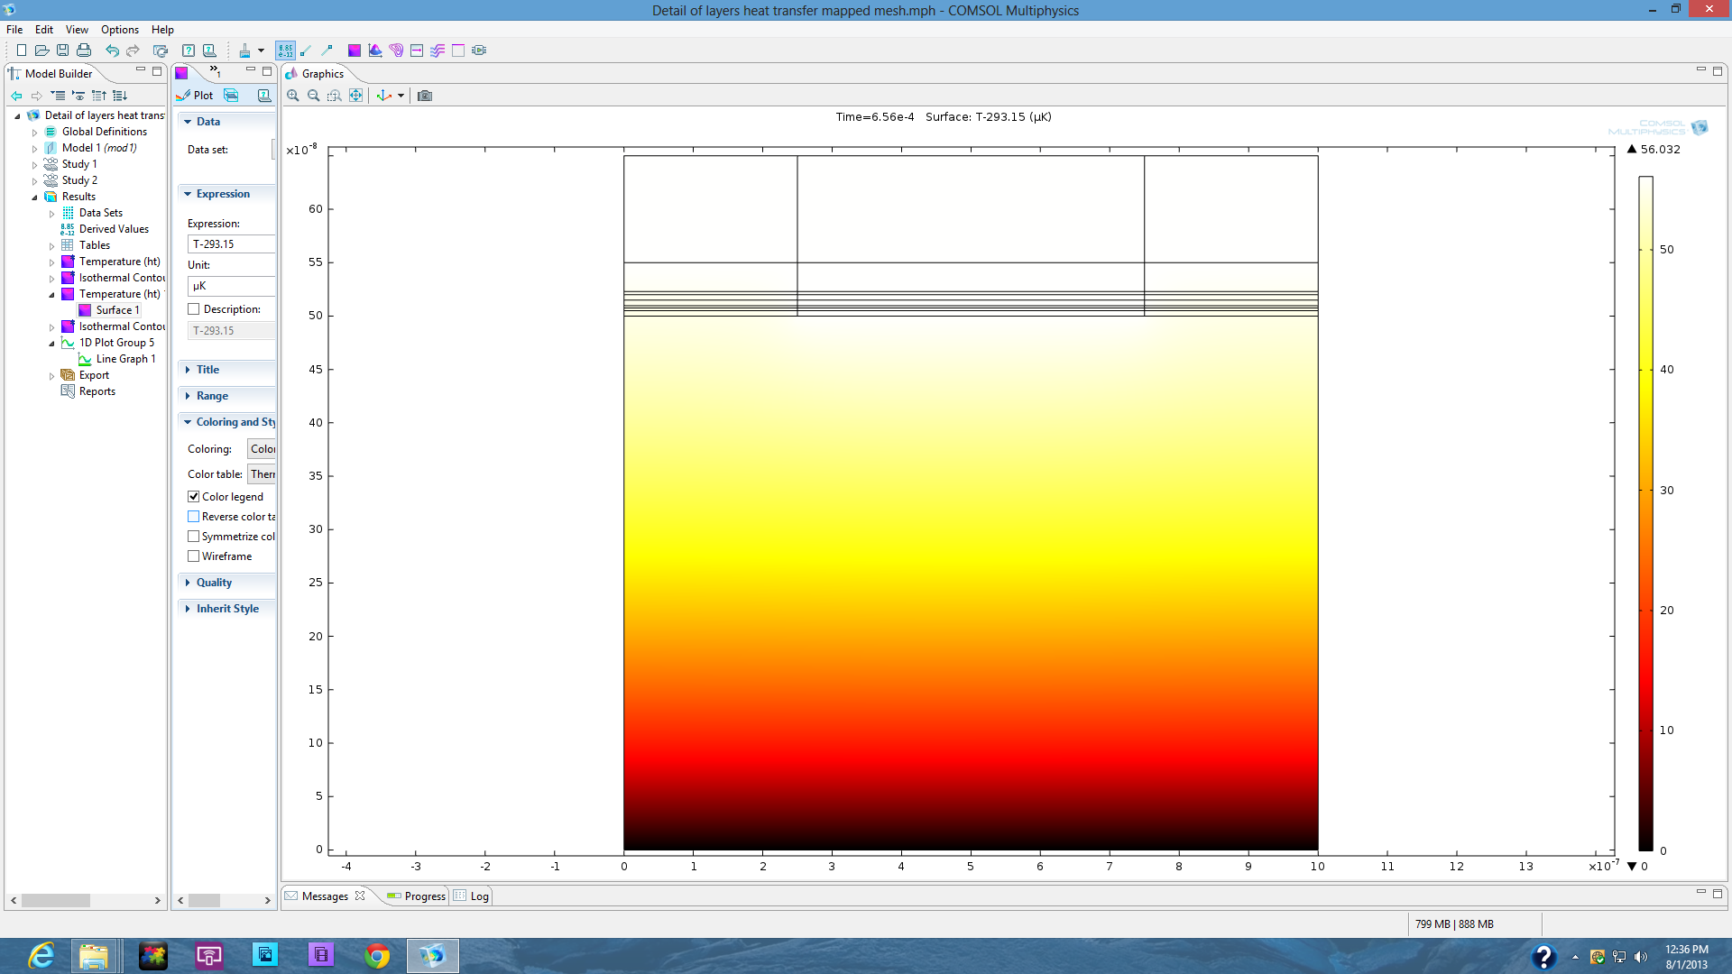
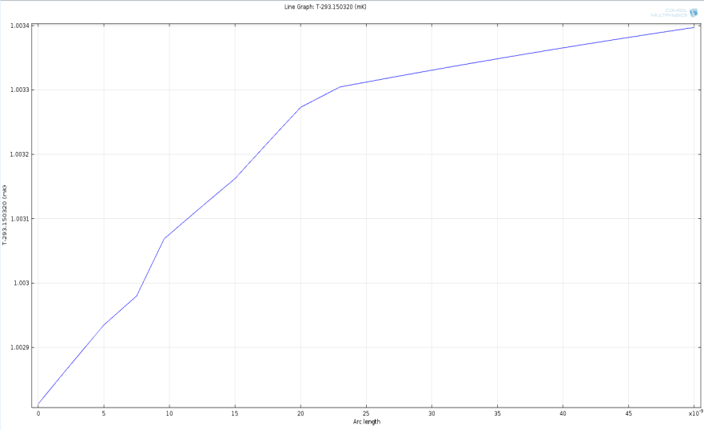
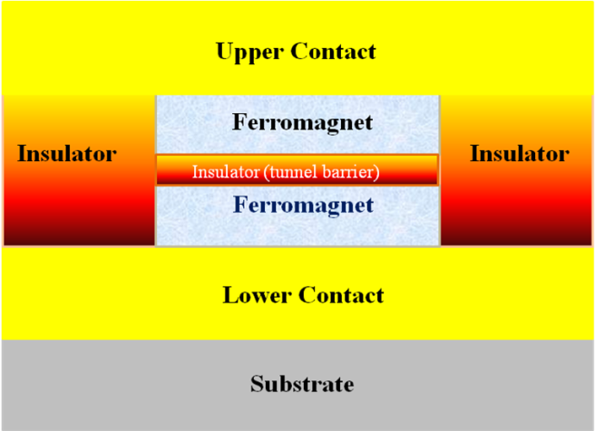
Heat flux simulation using COMSOL
http://www.intechopen.com/books/electronic-properties-of-carbon-nanotubes/carbon-nanotube-based-magnetic-tunnel-junctions-mtjs-for-spintronics-application

Slide 12
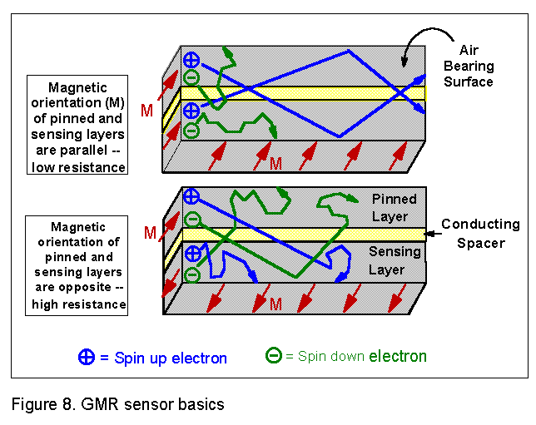
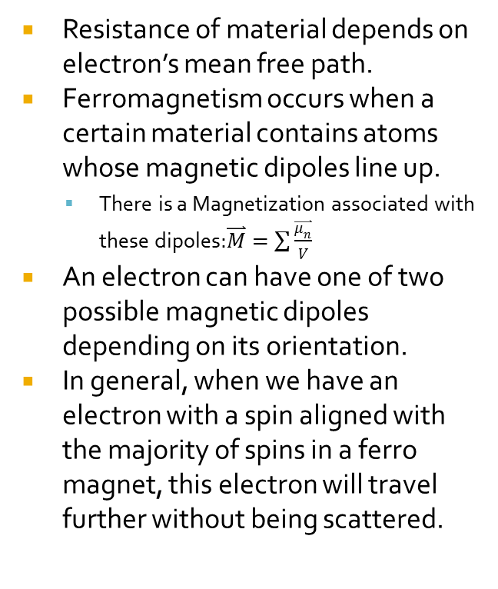
Resistance of GMR
https://www1.hgst.com/hdd/technolo/gmr/gmr.htm

Slide 13
Other Applications of Spin-tronics
Bio-sensor
An analytical device, used for the detection of a substance or chemical constituent that is of interest in an analytical procedure, for a biological component.
Spin Battery
Quantum Computing

Slide 14
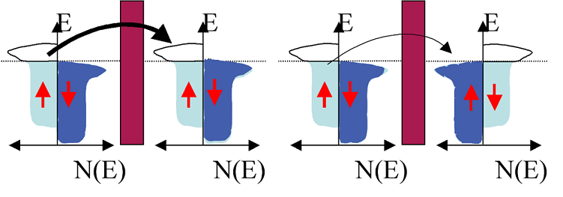
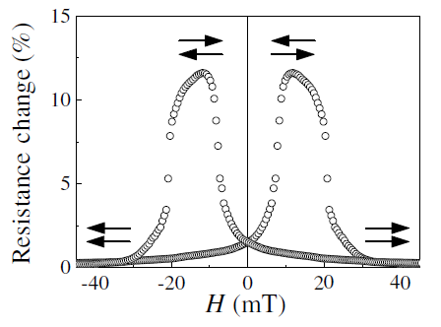
Tunneling Magnetoresistance (TMR)
Parallel
Anti-Parallel
Conservation of spin during tunneling.
Conductance product of the DOS of two FM electrodes
Weigang Wang
14

